Slide 1
British Tradition
two thousand years
English teacher:
Galina Koshkina
Toki 2010

Slide 2
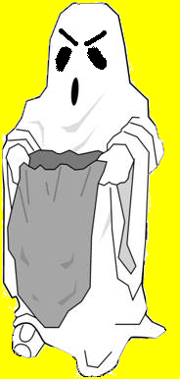
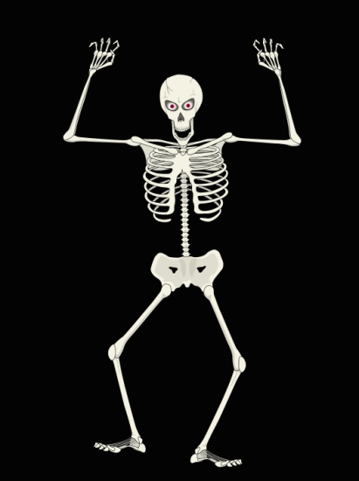
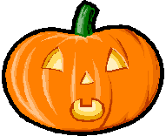
October, 31
witch
bat
Halloween
skeleton
pumpkin
ghost

Slide 3
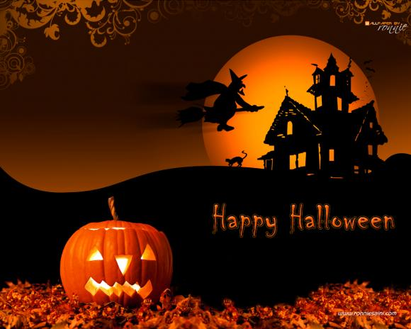
witch
pumpkin
pumpkin

Slide 4
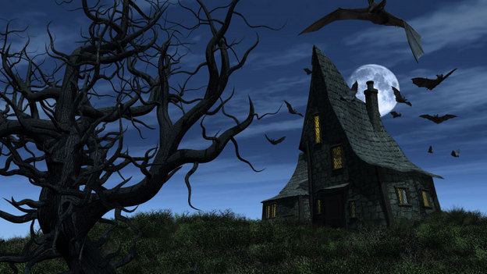
bat

Slide 5
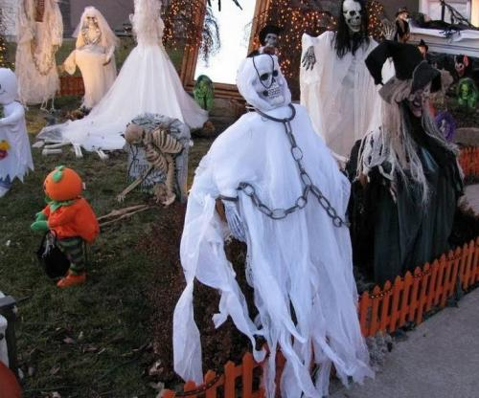
ghost

Slide 6
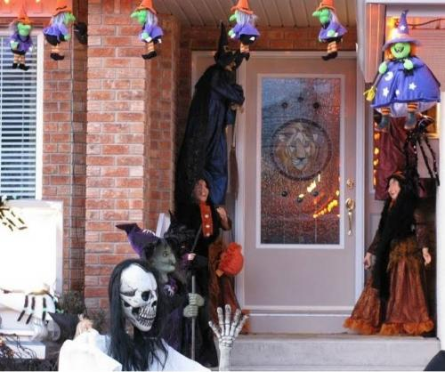
witch

Slide 7
http://www.wallpapergate.com/halloween.html
http://iloveportlandmaine.wordpress.com/2009/10/
http://www.npr.org/templates/story/story.php?storyId=114176451&ft=3&f=1032
http://www.driverblogs.ru/blogs/travel/23.php
http://www.driverblogs.ru/blogs/travel/23.php

